Slide 1

Machine Learning in Biology and Healthcare
Machine Learning Approaches for Predicting Heart Disease
Presented by Diya Ganesh
GN 428 - Introduction to Machine Learning in Biology
04/30/2026

Slide 2
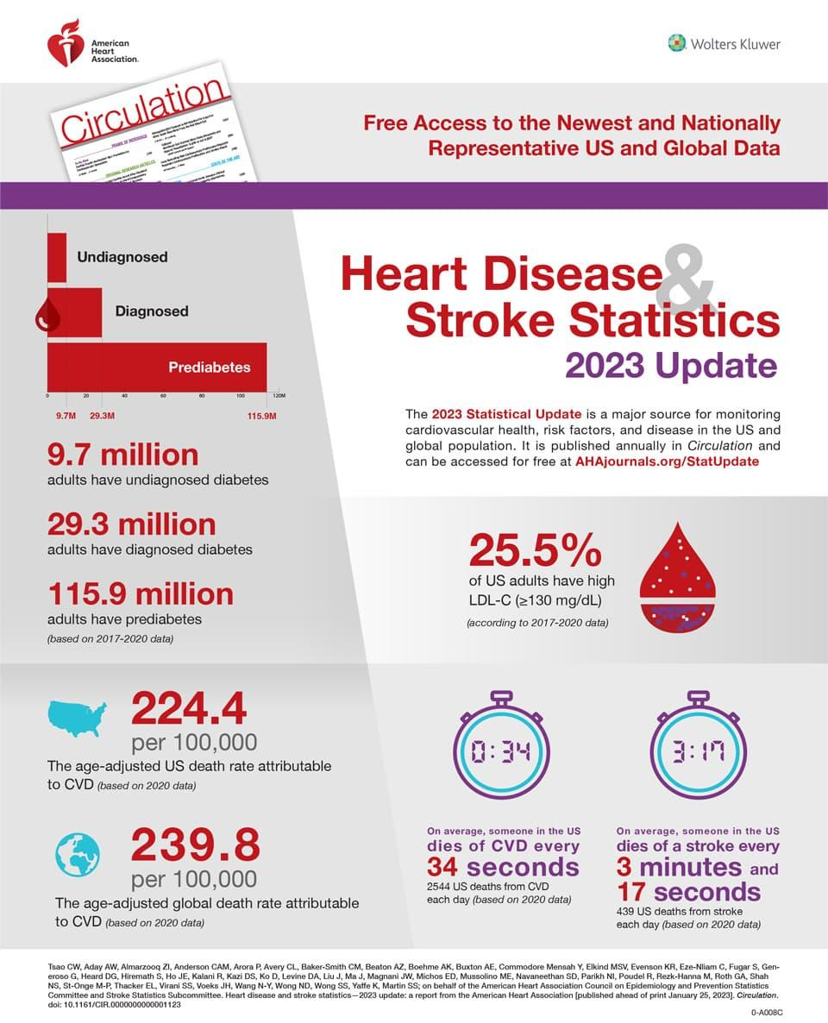
Introduction
Heart disease is a leading cause of death worldwide
Early detection improves patient outcomes
Machine learning can analyze clinical patterns
Goal: predict presence or absence of heart disease

Slide 3
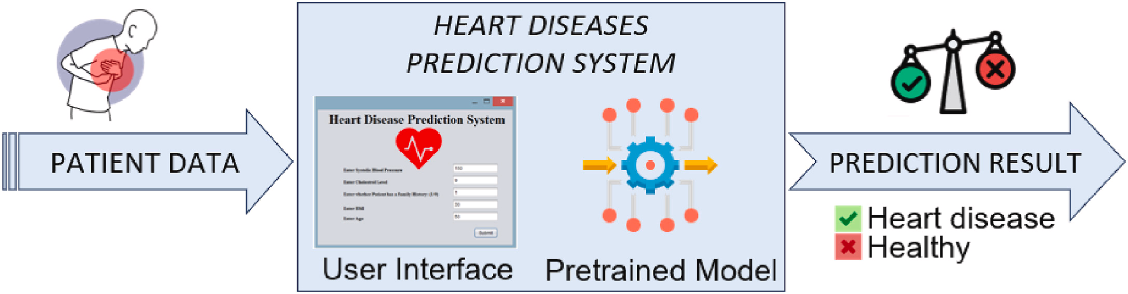
Hypothesis
Clinical and physiological features are associated with heart disease and that machine learning models can predict disease presence

Slide 4
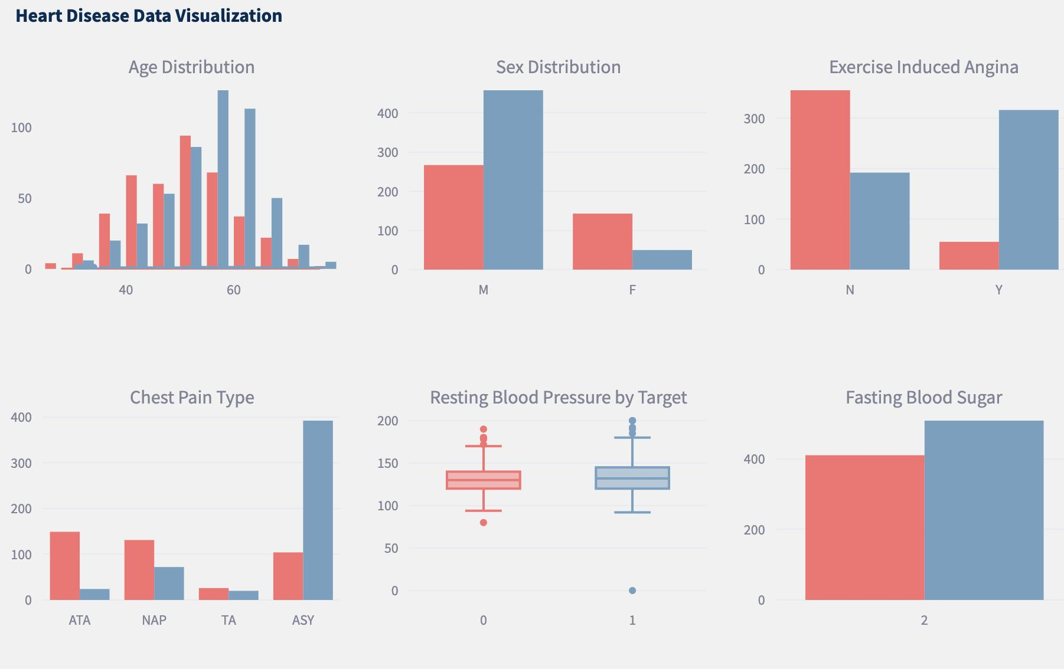
Dataset
Heart disease dataset
Outcome:
0 = No heart disease
1 = Heart disease
Features include:
Chest pain type
ECG results
Exercise-induced angina

Slide 5
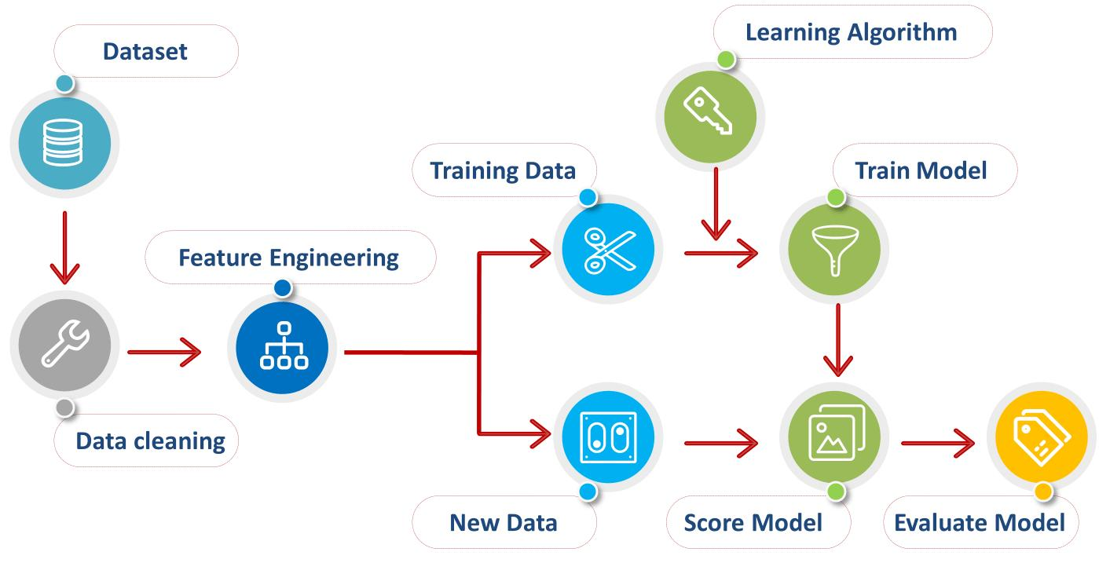
Data Processing
Converted categorical variables to factors
Checked for missing values
Removed duplicate observations
Split data:
70% training
30% testing

Slide 6
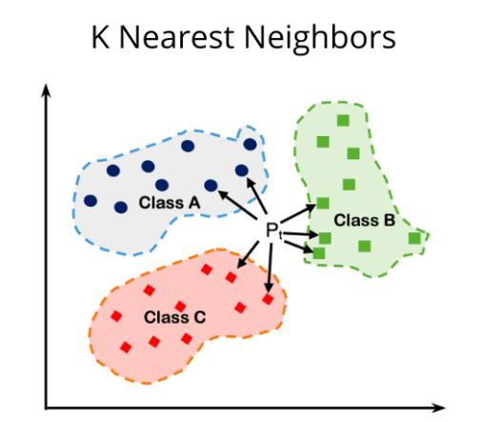
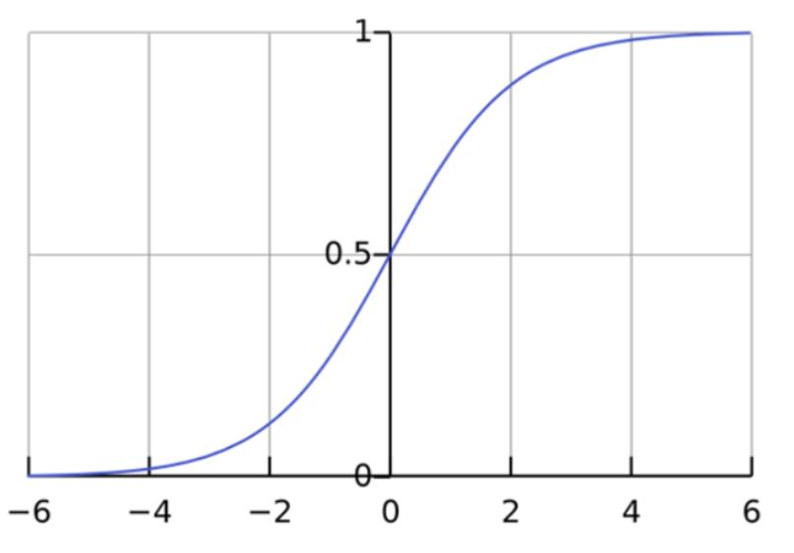
Models Used
Decision Tree
Logistic Regression
K-Nearest Neighbors (KNN)

Slide 7
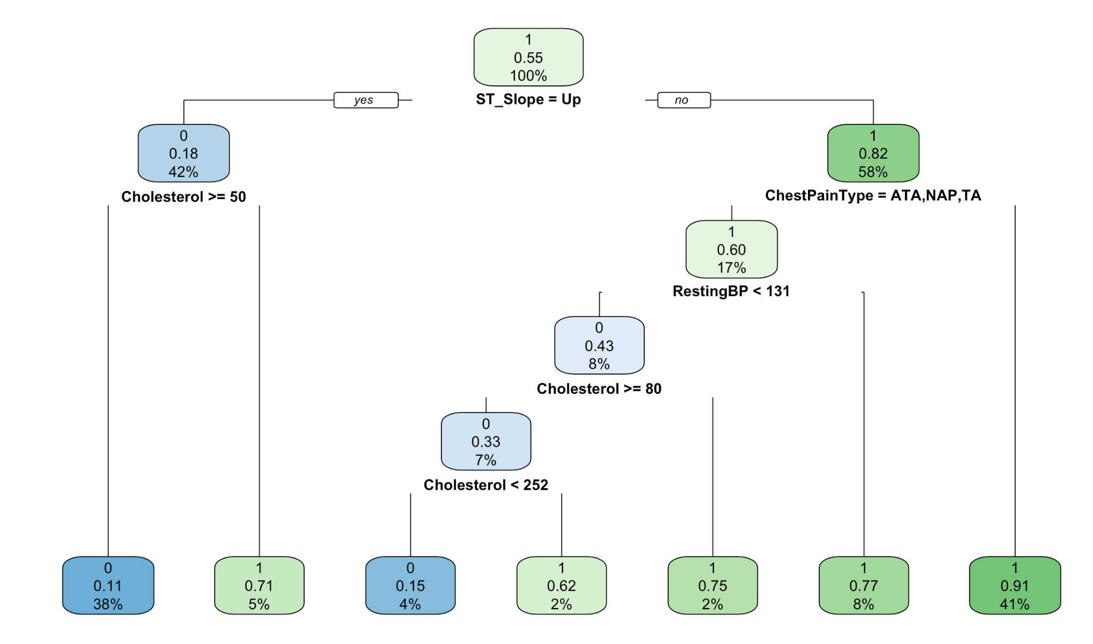
Decision Tree Model - Figure

Slide 8
Results
Model | Accuracy | Sensitivity | Specificity
Decision Tree | 82.97% | 83.87% | 81.82%
Logistic Regression | 87.68% | 89.03% | 85.95%
KNN | 87.68% | 90.97% | 83.47%

Slide 9

Discussion
Logistic Regression & KNN had highest accuracy
KNN had highest sensitivity → best at detecting heart disease
Sensitivity is important to reduce false negatives
Decision tree helped identify key features

Slide 10

Conclusion
Machine learning can predict heart disease
KNN best for identifying disease cases
Logistic regression strong overall performance
Future goal: improve sensitivity

Slide 11
References
fedesoriano. (September 2021). Heart Failure Prediction Dataset. Retrieved [04/25/2026] from https://www.kaggle.com/fedesoriano/heart-failure-prediction.

